Slide 1
Training session on CMS Student Portal

Slide 2
Objectives of Training
Objective of this training is to facilitate or trained the students about Student CMS Portal containing Fee, Result, Attendance and Survey.

Slide 3
Outlines of Training
** How to Login to the system
** How to download fee slip/fee voucher
** What will be the next step after paying the fee
** Common mistakes performed by the student during downloading/paying fees.
** How to attempt survey, view Result and Attendance

Slide 4
How to Login to the system

Slide 5
We can login/sign in to CMS in two ways Throgh website www.uom.edu.pk Or throgh URL cms.uom.edu.pk

Slide 6
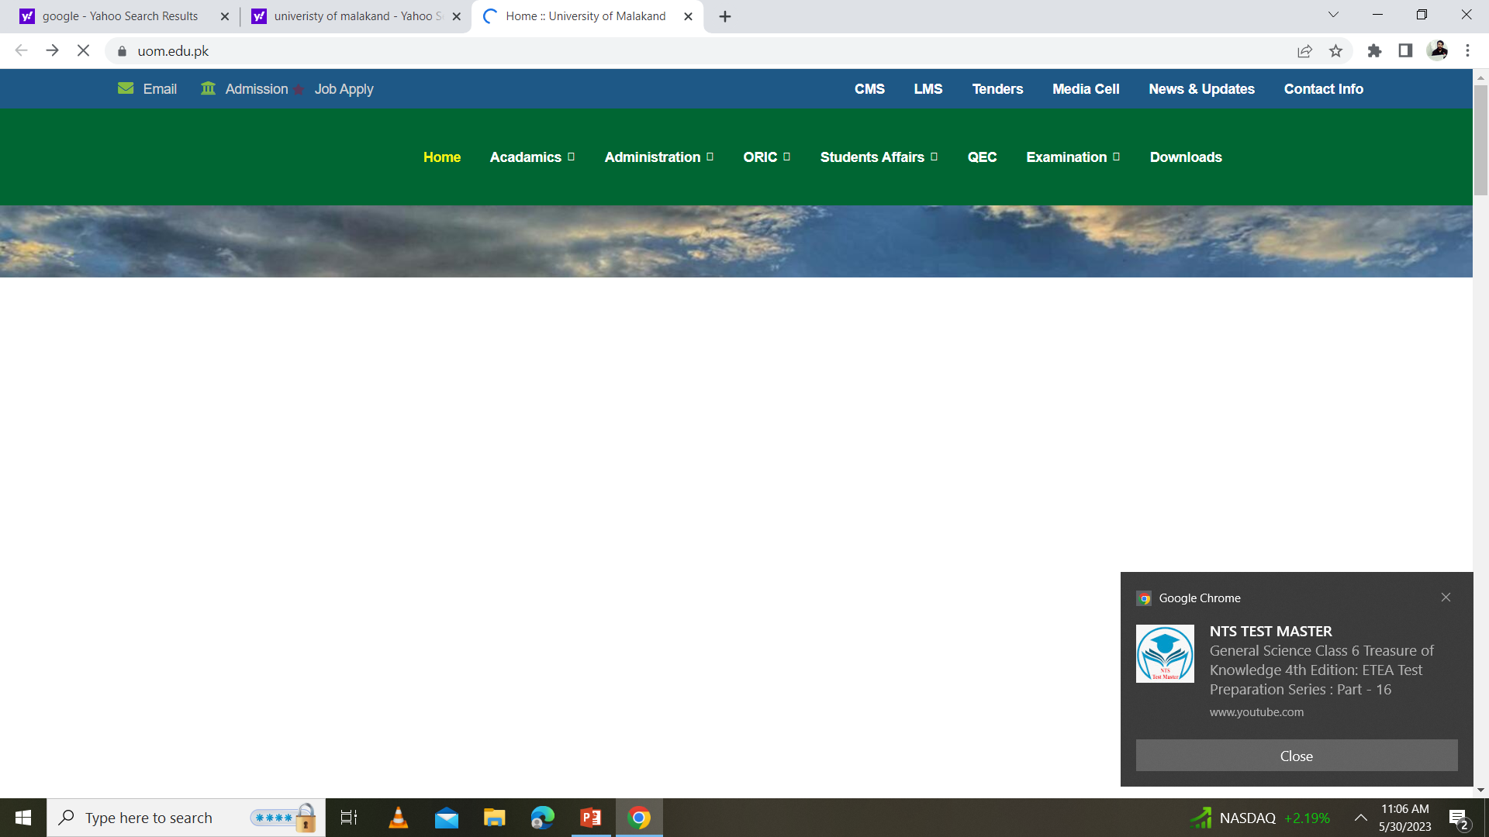
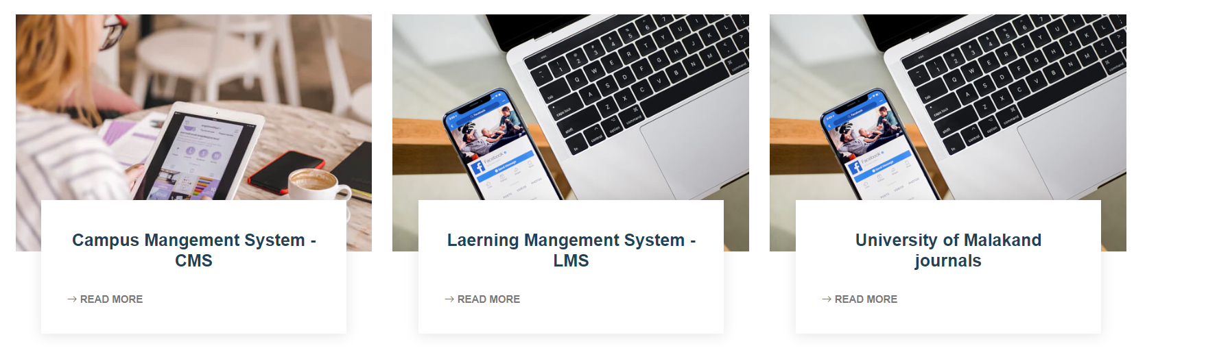
Login Through website
www.uom.edu.pk

Slide 7
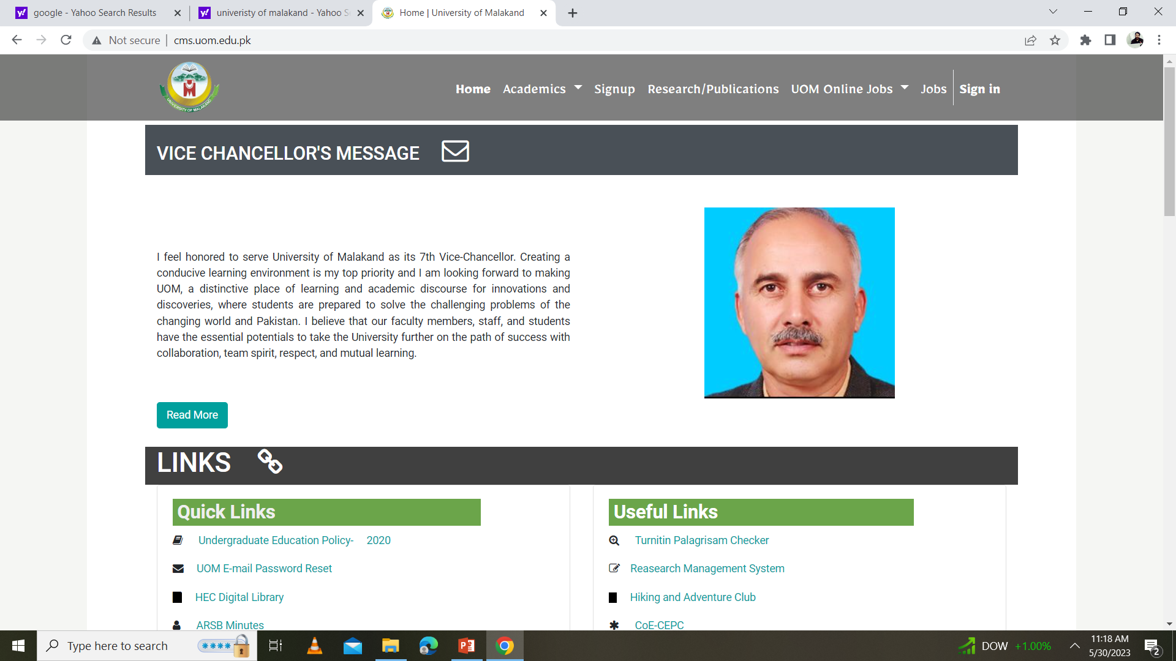
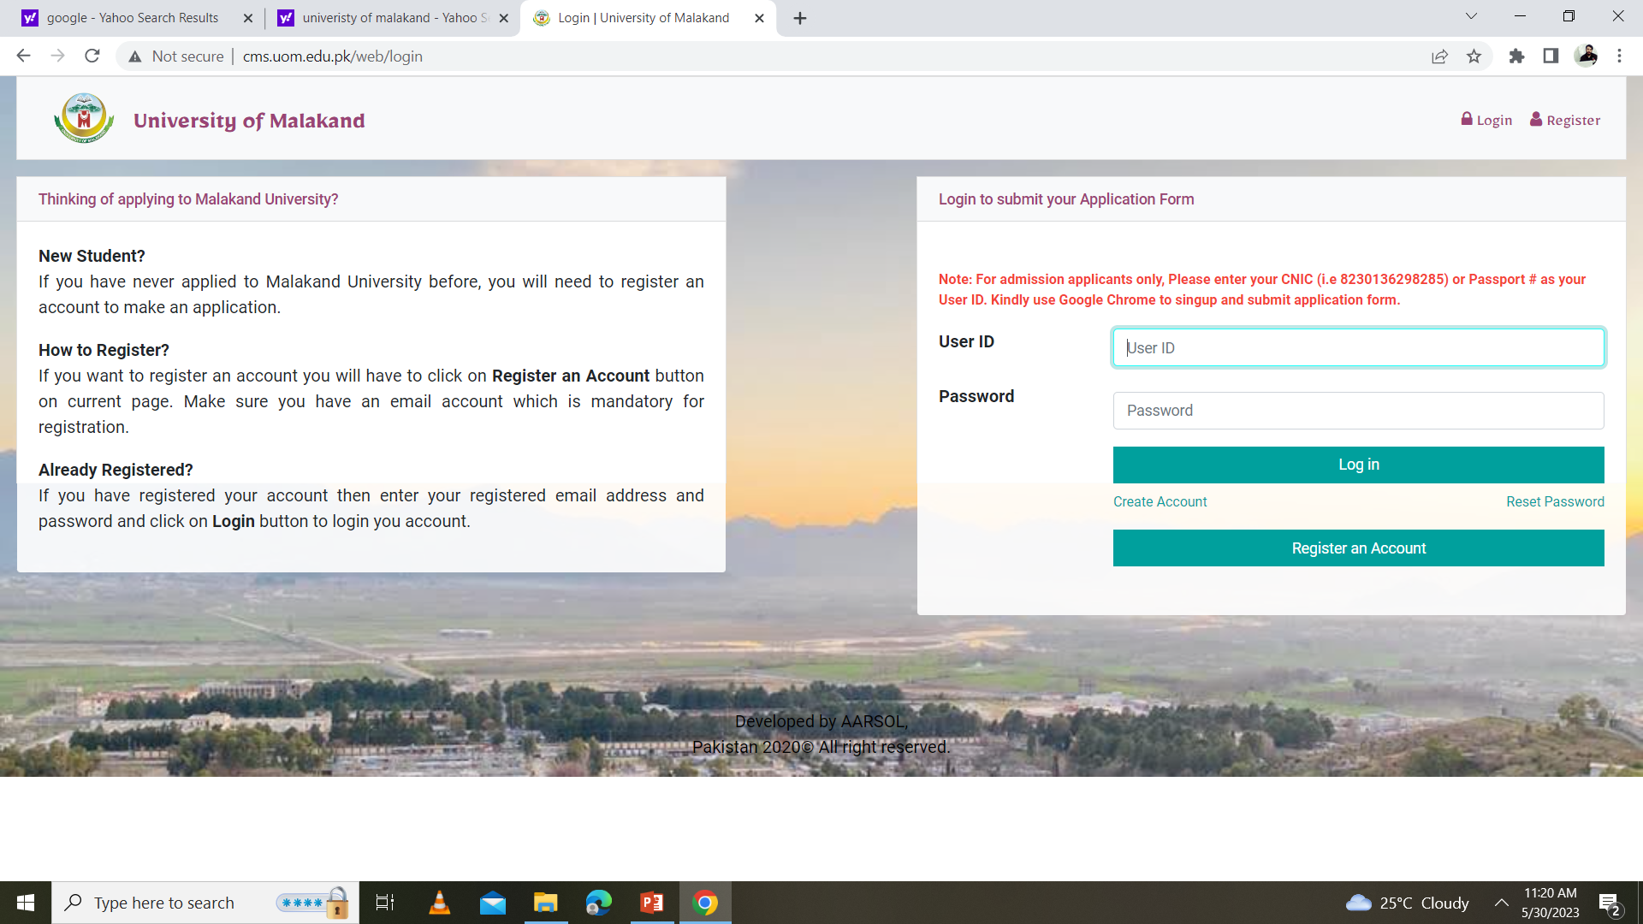
Login Through URL
cms.uom.edu.pk

Slide 8
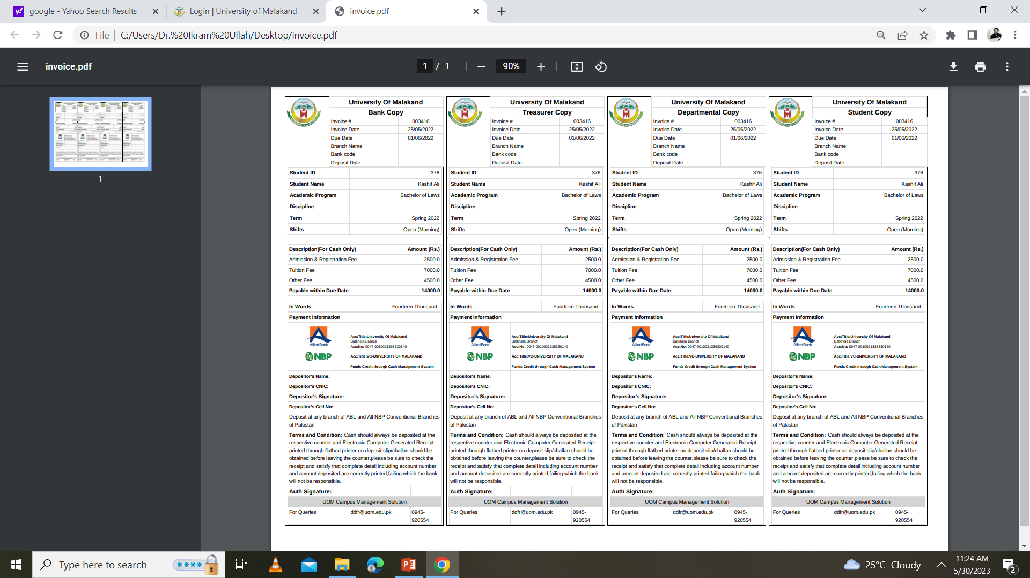
Mistakes performed by the students during downloading/paying fee students paid multiples fee on the same voucher having the same barcode/Invoice number and same term, we strictly need to avoid these types of mistakes, otherwise, it will consider only one fee.

Slide 9
Solution
To avoid these mistakes students need to see and verify the Invoice number and term on the fee receipt before paying a fee.

Slide 10
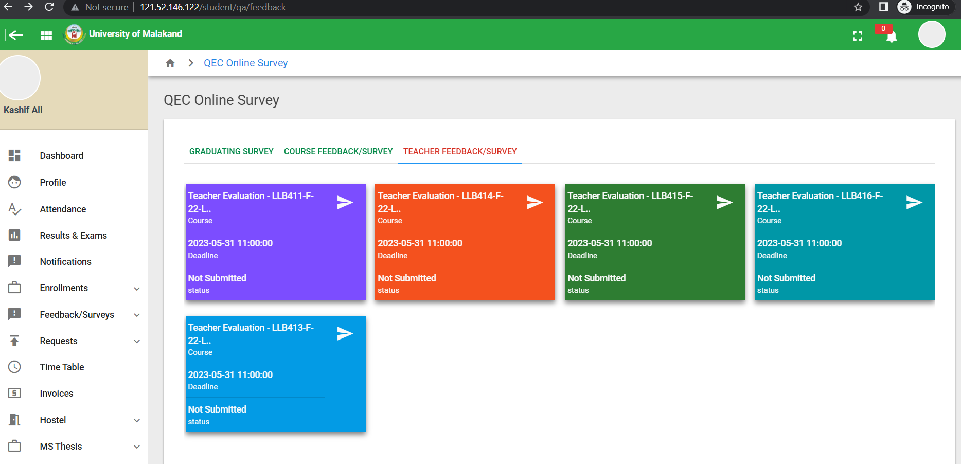
Attendance, Survey, Result

Slide 11
Thanks!
Any questions?

